Slide 1
PHARMACY SYSTEM PHASE 2
Abdelrahman ragab elabasiery(19103032)
Mariam Hossam eldeen younis (19100240)

Slide 2
The concept
The system can be used by customers who wants to buy from the pharmacy the medicine they need or the manager who wants to view and monitor the updates of the workers and medicines. He can also know the expired and running out medicine so he can get rid of the expired and reorder the needed medicines.

Slide 3
Classes
We have 8 classes. Some patterns are used like strategy pattern in the payment method to give the customer the flexibility in choosing between the credit card or cash. Also singleton pattern is used in the manager class because any pharmacy has only one manager so singleton will prevent the creation of several managers after creating the first one.

Slide 4
GUI
The project is 12 forms. 5 forms for the admin which consists of one login form for the admin to enter his password to ensure security that no other user can enter the admin forms. And 6 forms for the customers having one form of creating new accounts and another for signing in for already registered accounts in the data base. The colors used in the GUI are gradients of blues to give the program users the calmness and serenity mood.

Slide 5
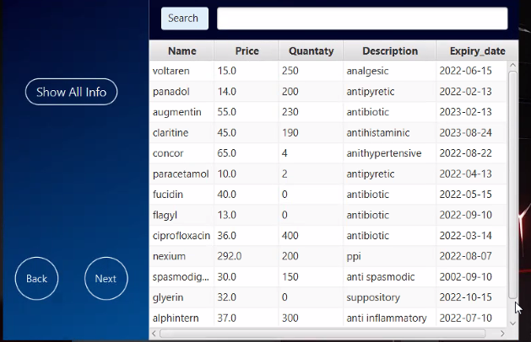
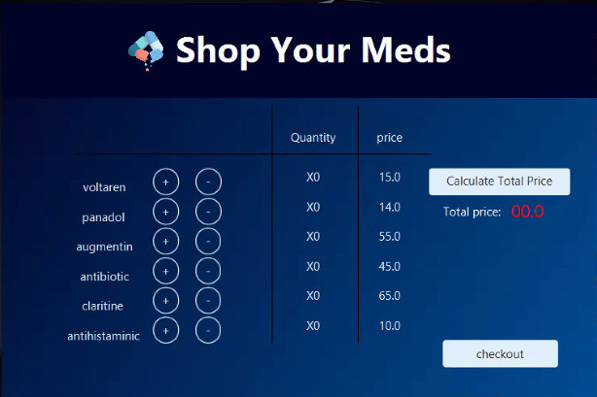
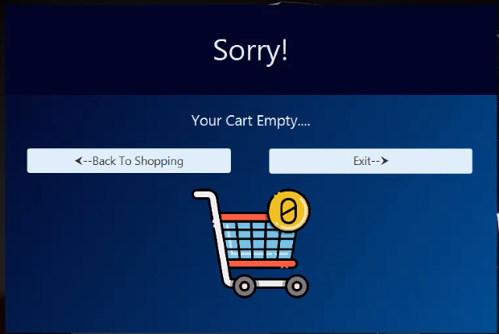
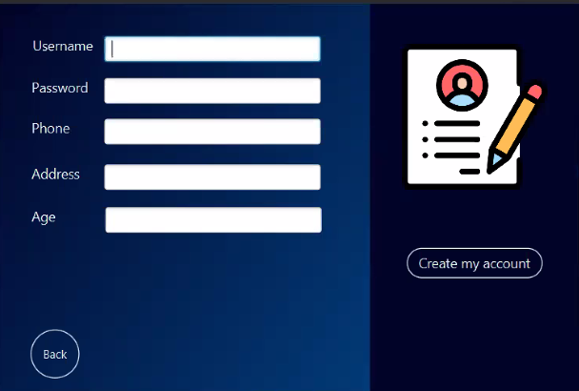
Some forms samples

